Slide 1

QR Code Scanner
Saylee surve
Aaditya auti
BHARAT KOLEKAR
TEJAS LAD
648
658
659
660

Slide 2
What is QR and Bar code-?
Barcode provides us with the way to store numbers in a computer understandable format. This is used to store information in a 1D or 2D format can be scanned for data retrieval. It is used by stores back off sweaters for keeping track of the patients just in case of rental car services to track where the car is in cases of airline luggage.
QR codes are a way of storing data in the form of computer understandable format, that can be scanned by using QR code scanner to retrieve the data. These are widely used nowadays for cashless and UPI payment services. They can be used in case of identifications and are also used for sharing photos, videos and other files.

Slide 3
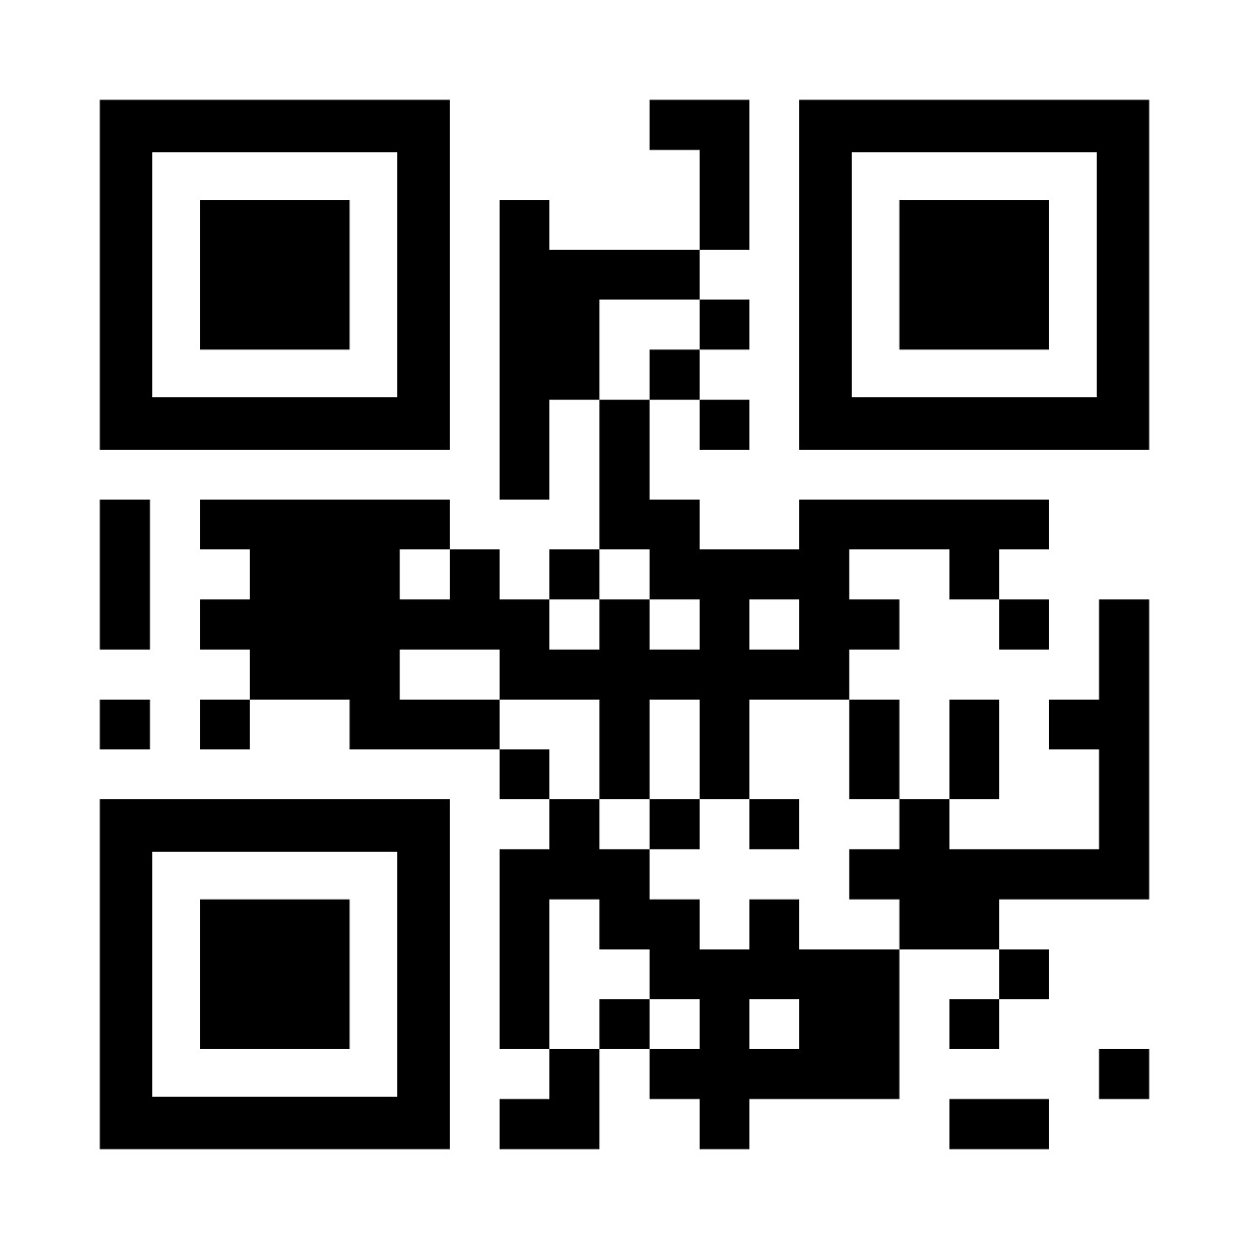
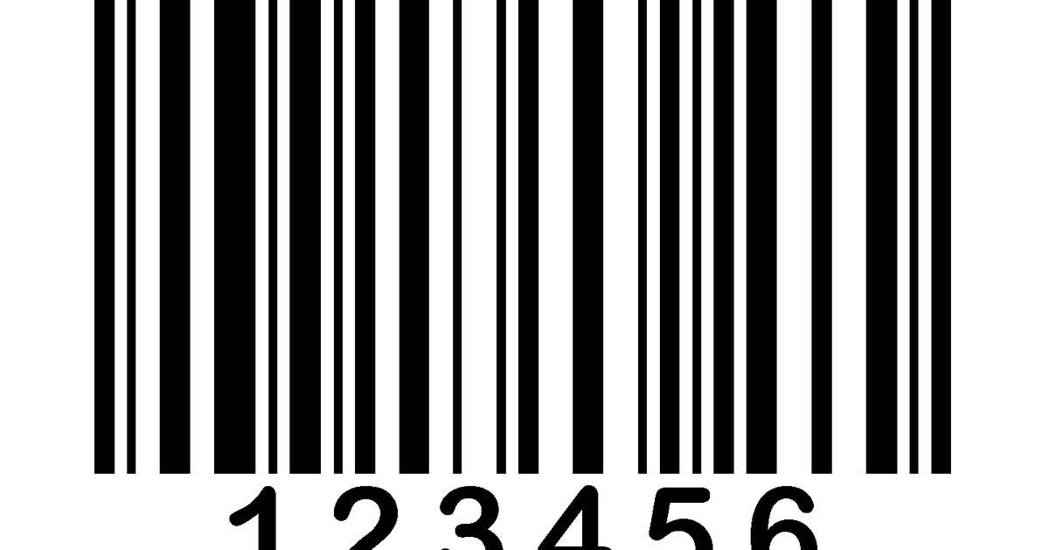
How they look…?

Slide 4
Flow of Project
Recognizing and decoding the barcode/QR code that we will be showing to the camera.
Adding the stored information as a text on the recognized barcode/QR code.
And lastly, exporting the stored information as a text document.

Slide 5
Library used in project
Pillow
OpenCV
Pyzbar

Slide 6
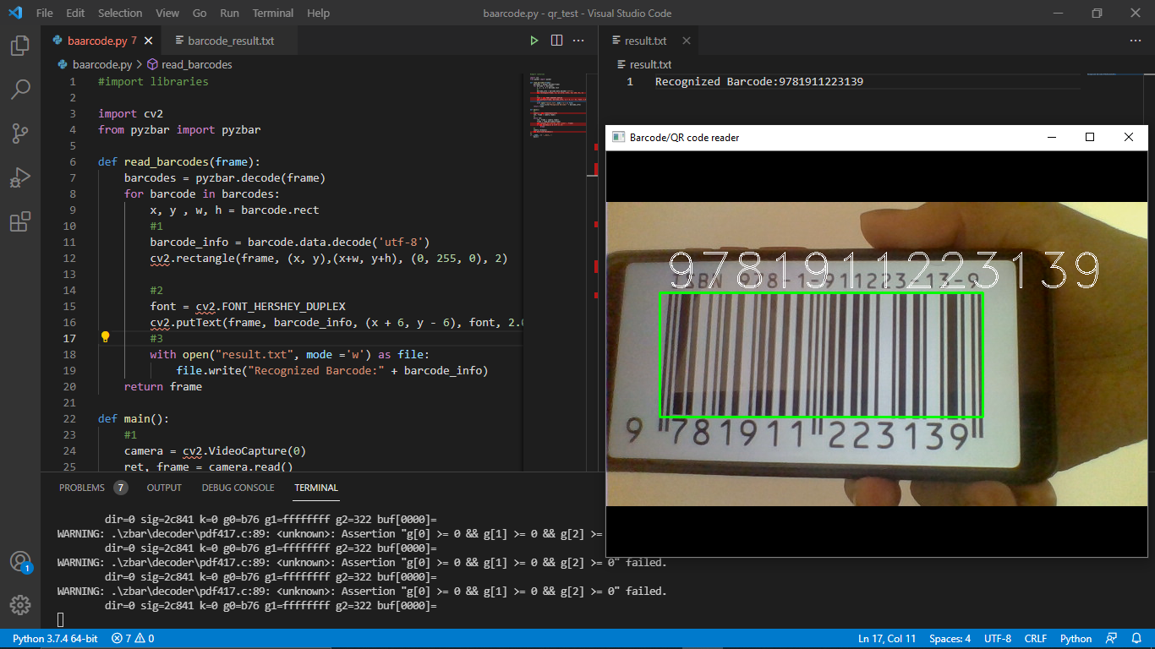
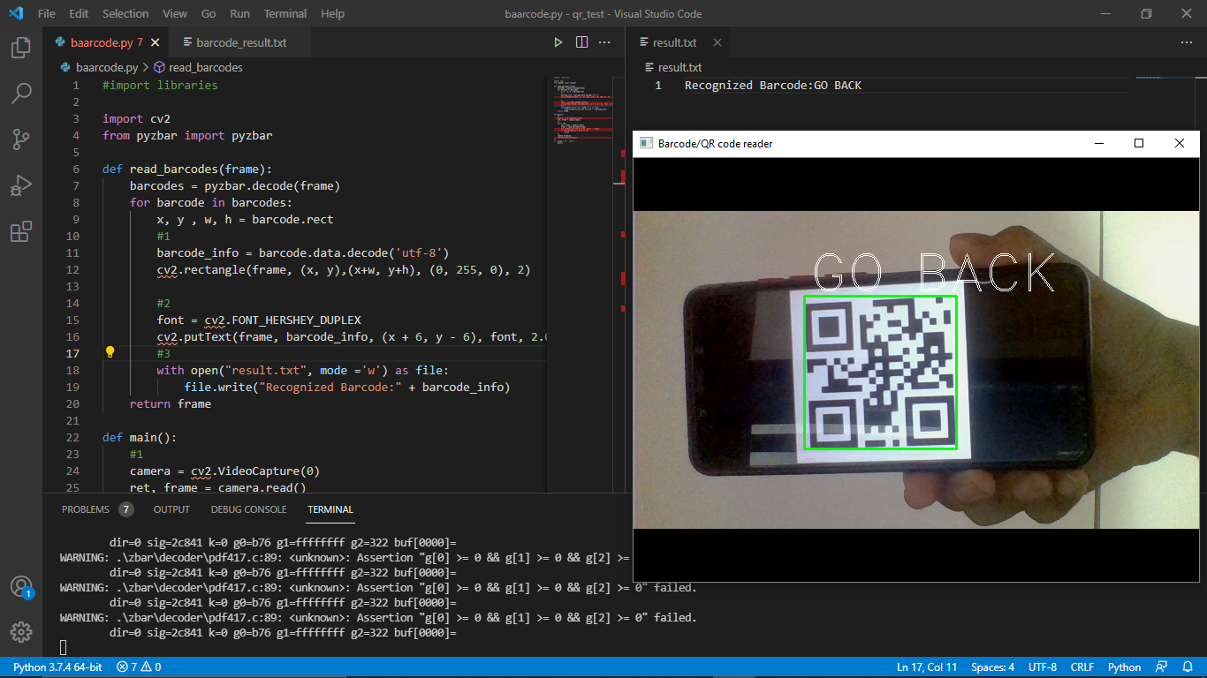
OUTPUT

Slide 7
OUTPUT

Slide 8
Future Scope
We can use this system in many robot specific application.
Also this system can be used in heritage places to book tickets.

